Slide 1
Response Prediction and Clustering on Social and Criminal Networks
By: Aamir Mandviwalla

Slide 2
Who am I?
Aamir Mandviwalla
Computer science PhD student at RPI
Dr. Szymanski is my advisor
B.S. in Mathematics and Computer Science with Teaching from Temple University in 2019

Slide 3
Paper 1 – Analyzing Trendy Twitter Hashtags in the 2022 French Presidential Election

Slide 4
Problem: Rich features used to train predictive models are often too computationally intensive to use on enormous datasets
When working with hundreds of millions of social media messages, the time complexity of many of the most popular features becomes prohibitive
Can we develop a simple feature that can be used to boost predictive model performance that has a low complexity?

Slide 5
DARPA INCAS Project
The Influence Campaign Awareness and Sensemaking (INCAS) project
“The U.S. is engaged with its adversaries in an asymmetric, continual war of weaponized influence narratives,” said Brian Kettler, the Information Innovation Office (I2O) program manager leading INCAS. “The combination of connectivity and modern media has greatly amplified the potential effects of geopolitical influence campaigns on populations. As adversaries seek to exploit misinformation as well as true information delivered via influence messaging, U.S. analysts need automated tools to help detect and make sense of adversarial influencer campaigns – allowing them to move away from largely manual and ad hoc approaches.”
We were tasked with predicting the response rate of Twitter users to various emotions during the 2017 and 2022 French Presidential Elections

Slide 6
Emotion Data
A separate INCAS team manually annotates the tweets collected that center on the 2017 and 2022 French Presidential Elections
Each tweet is given a total value between 0 and 1 (1 indicating this is the only emotion present) for each of the following emotions:
Fear, Anger, Enjoyment, Sadness, Disgust, Surprise, or None of the above
Several thousand tweets are annotated by a team of annotators
Another INCAS team fits a model to the annotated tweets and uses it to assign values for the rest of the millions of tweets in the dataset
Our team was provided with the emotion labels for the months leading up to the election and asked to predict the emotion labels for the month of the election

Slide 7
Background on 2017 and 2022 French Elections
French presidential elections – once every 5 years
Initial round with all candidates – top 2 advance to second round
2017 - Five main candidates:
Jean-Luc Melenchon (far left wing) – 19.5% vote
Benoit Hamon (left center) – 6.3% vote
Emmanuel Macron (center) – 24.0% vote
Francois Fillon (right center) – 20.0% vote
Marine Le Pen (far right wing) – 21.3% vote
Le pen and Macron advanced – Macron won (66.1% vs. 33.9%)
2022 – Three main candidates:
Jean-Luc Melenchon (far left wing) – 21.95% vote
Emmanuel Macron (center) – 27.85% vote
Marine Le Pen (far right wing) – 23.15% vote
Le pen and Macron advanced – Macron won (58.55% vs. 41.45%)

Slide 8
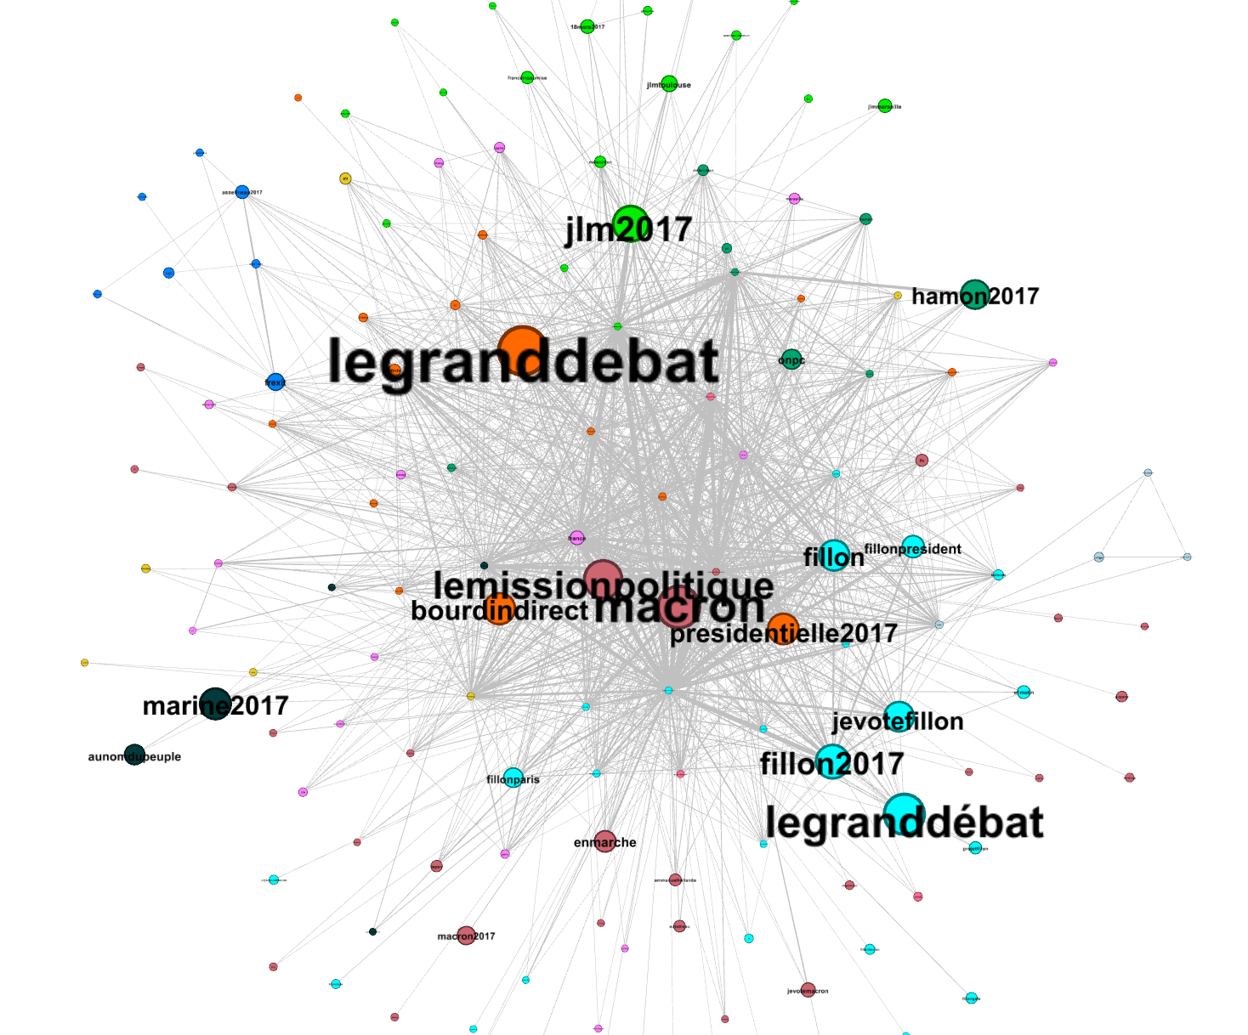
Trend-Trend graph
Some studies have shown that simple semantic network features can be rich enough to use for regressions without requiring complex computations.
We create a weighted semantic network between Twitter hashtags from a corpus of 3.7 million tweets related to the 2017 French presidential election.
A bipartite graph is formed where hashtags are nodes and weighted edges connect the hashtags reflecting the number of Twitter users that interacted with both hashtags.
The graph is then transformed into a maximum-spanning tree with the most popular hashtag (#france) as its root node in order to construct a hierarchy amongst the hashtags. We then demonstrate the viability of using this tree to help predict users’ response rates to various emotions

Slide 9
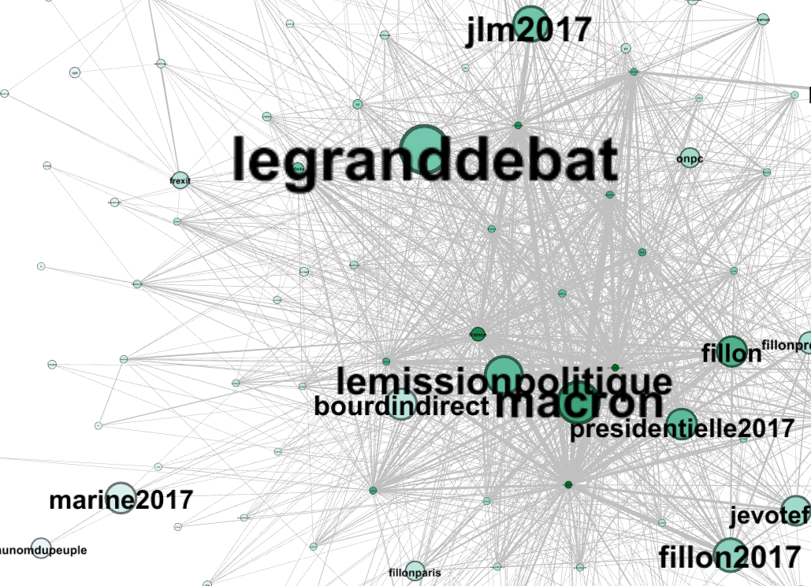
Isolation
Size of nodes based on total # of mentions
Darker color for greater degree in trend-trend graph
Far-right candidate (marine2017) similar size to other candidates but much weaker connection to the graph
Users that post about this trend do not frequently use other hashtags

Slide 10
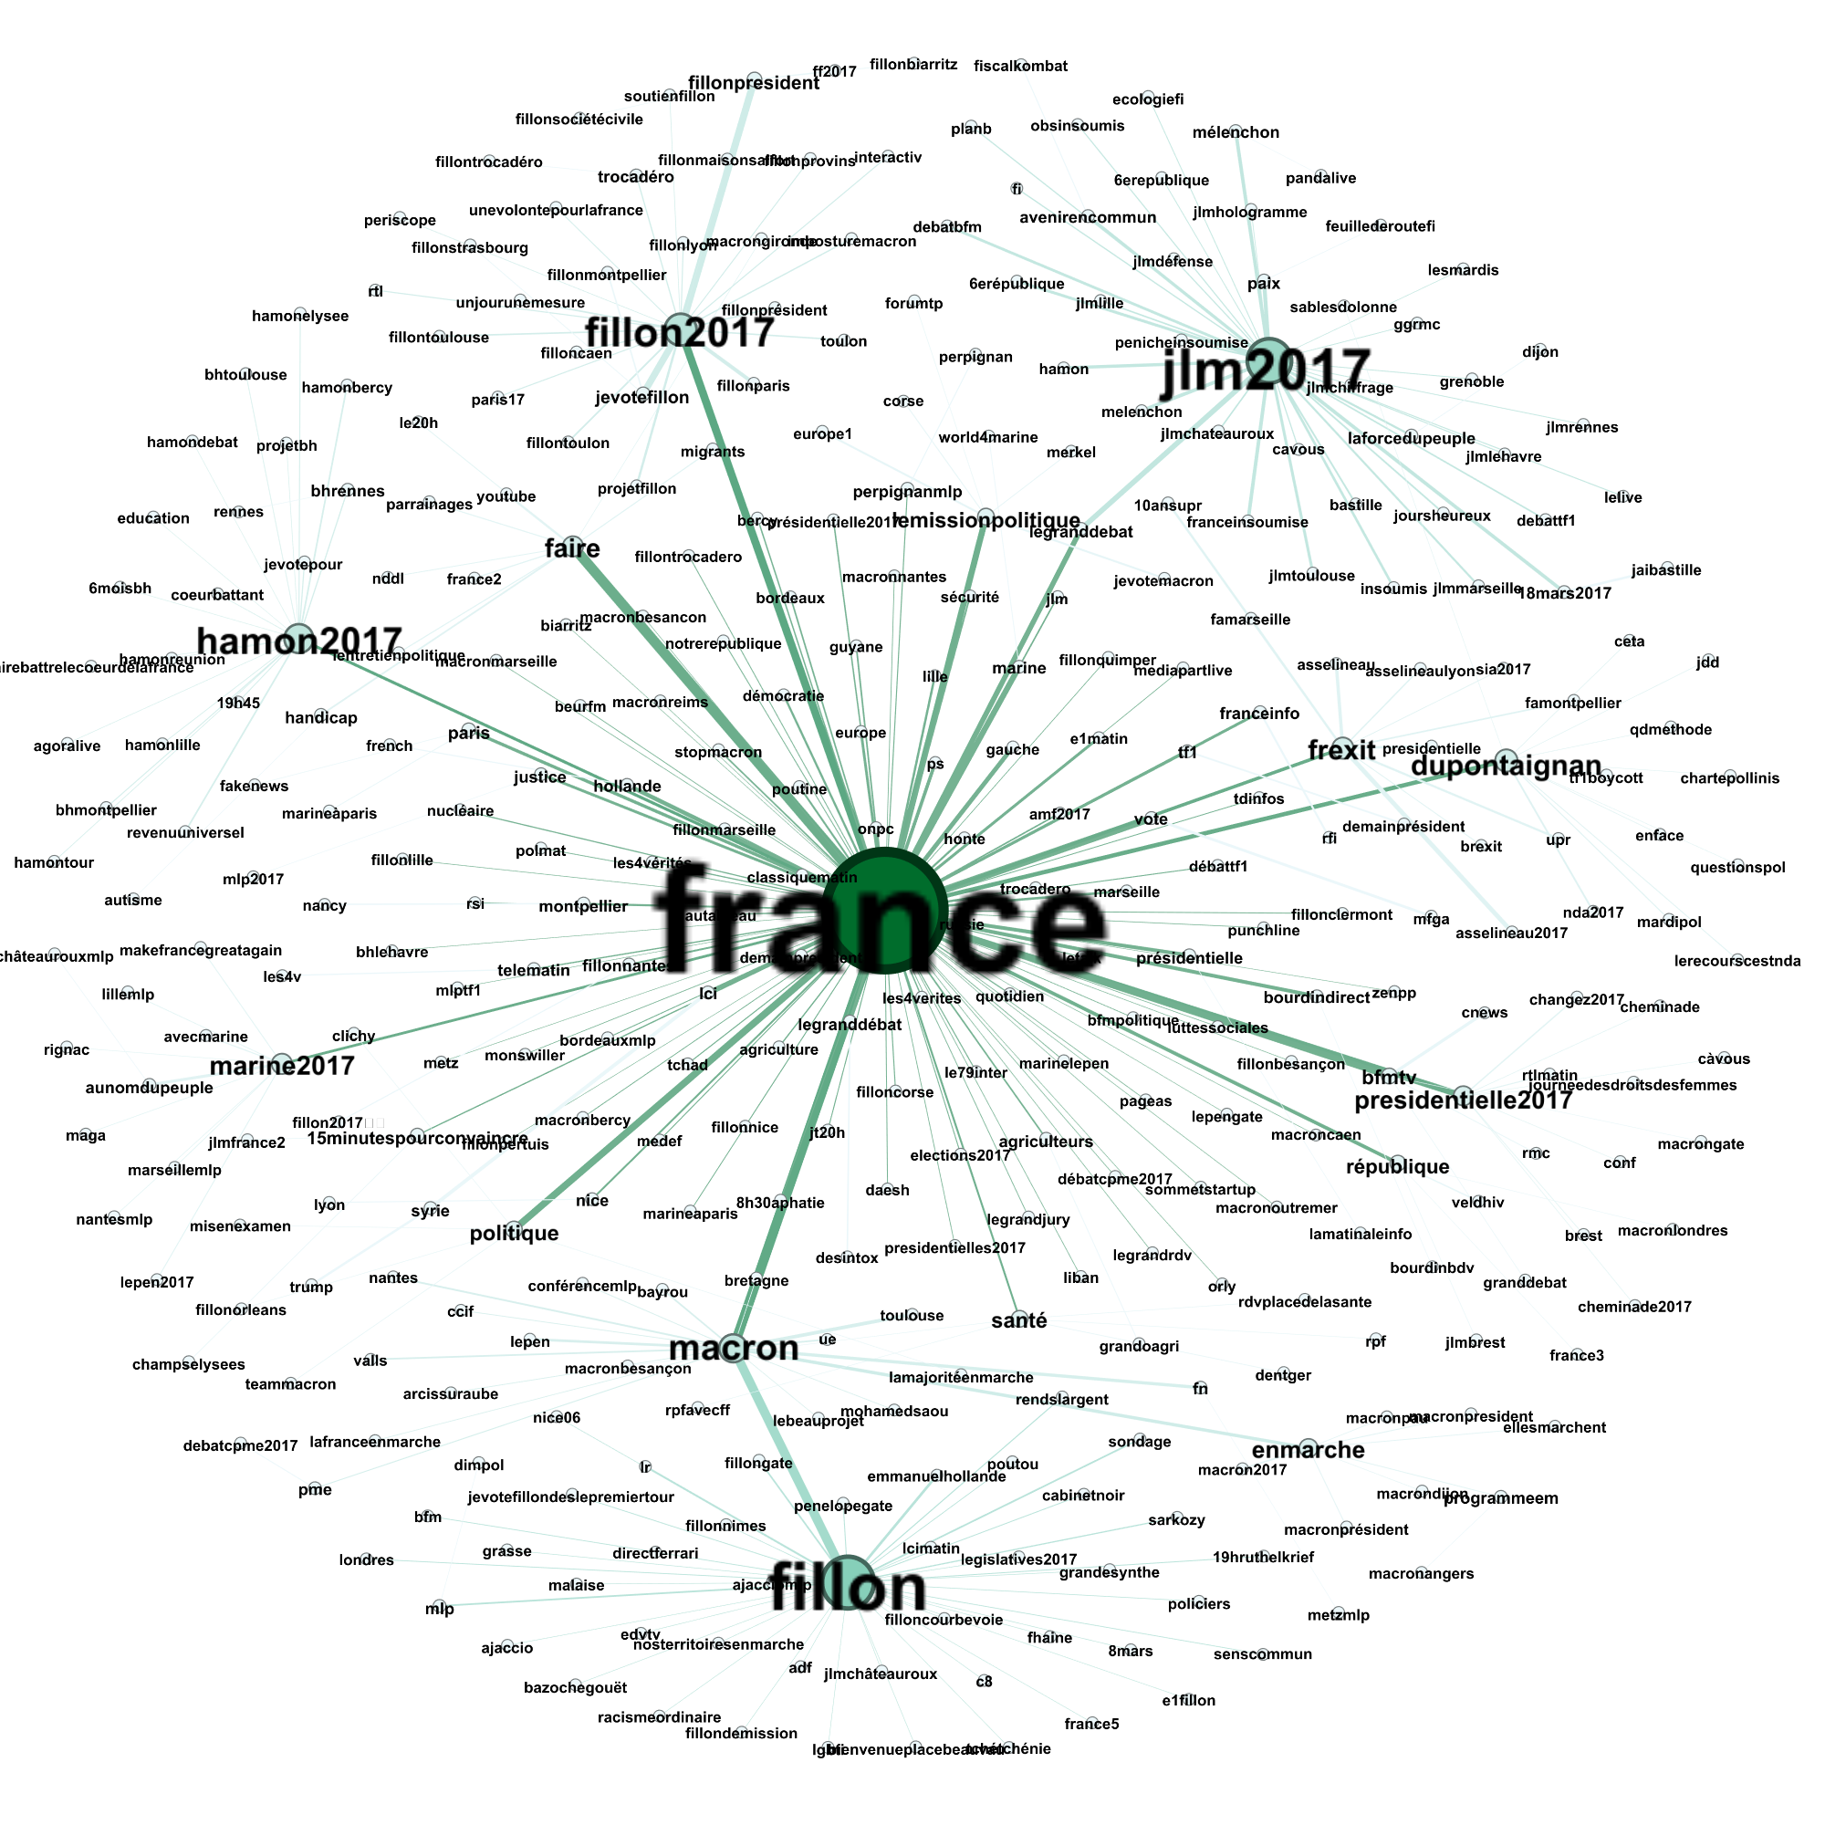
Trend-Trend Maximum Spanning Tree

Slide 11
Francois Fillon

Slide 12
Marine Le Pen (mlp)

Slide 13
Hashtag Features
Baseline Feature:
Count the number of times each user interacted with each hashtag and provide this as a vector feature for each user
Tree-based Feature:
Count the number of times a user interacted with each hashtag and all of the children of that hashtag in the tree and provide this as a vector feature for each user
As we are focusing on providing a useful feature to help the team (2 members out of about 30) with their response rate prediction, we will test these two features with a simple linear regression

Slide 14
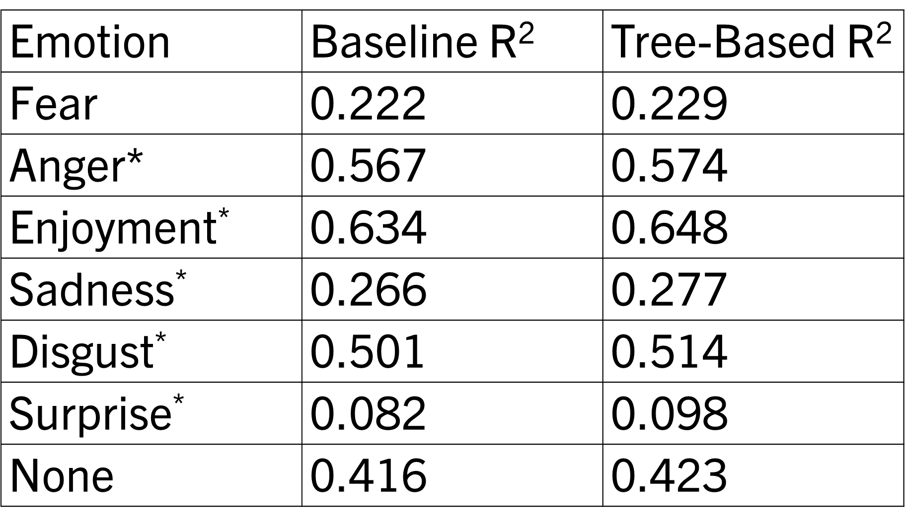
Linear Regression Results
Tree-Based feature gives a statistically significant improvement to prediction accuracy for 5/6 emotions
“Analyzing Trendy Twitter Hashtags in the 2022 French Presidential Election” (Mandviwalla, Yin, Szymanski Complex Networks 2023)

Slide 15
Conclusions
It is possible to capture strong hierarchical language-relationships without computationally-intensive language-processing
This information can be used effectively to help predict the social media behaviors of users
Approaches like this may be useful in applications dealing with Big Data
Future: Can we find a better way to integrate the maximum-spanning tree into response predictions? Or another useful application for the tree? Program was renewed so lots of possibilities

Slide 16
Paper 2/3 – A Network Generator for Covert Network Structures

Slide 17
Problem: High Uncertainty in Covert Networks
Covert networks (including criminal and terrorist networks) have high uncertainty
Participants intentionally try to hide their activities
Legal restrictions make it difficult to obtain data and difficult to obtain accurate data
Uncertainty in everything – edge existence, edge weight, node membership, etc.
We will focus on community membership

Slide 18
Caviar Network
Project Caviar – Canadian police wiretapped a drug (hashish and cocaine) network between 1994 and 1996
Although 11 drug shipments were seized over the period, no arrests were made until the end of the investigation
318 individuals were named in the wiretappings. 110 were determined to have a clear participatory role in the network

Slide 19
Caviar Network
The network was released as a set of communication matrices by Carlo Morselli in his book “Inside Criminal Networks” in 2009.
Morselli got permission from the Montreal police to access their files. He collected over 1000 pages of telephone conversations
He released the data as a set of 11 snapshots. Each snapshot covers a 2 month span during the 22 month investigation.

Slide 20
Caviar 6
Snapshot 6 was identified as the most stable snapshot
In earlier snapshots, many of the participants have not been identified yet and there are less active wiretaps so there is less data
In later snapshots, the network begins to fall apart in reaction to law enforcement repeatedly seizing the network’s drug shipments
This snapshot features 27 nodes, and a total of 668 communications (avg of 24.7 communications per node)

Slide 21
Ciel Network
Project Ciel – another Canadian police wiretapping operation
A hashish network was tracked from May 1996 to June 1997
75 total individuals; 25 were identified with participatory roles
Three shipment seizures during the investigative period

Slide 22
Ciel Network
Again, Morselli obtained the data and published it in his book
Only 1 snapshot for the entire period
Much less observed activity vs. Caviar 6:
Ciel – 198 communications between 25 individuals over 13 months
Caviar 6 – 668 communications between 27 individuals over 2 months
15.2 comm/month for ciel vs. 334.0 comm/month for caviar
Why? (open to class discussion)

Slide 23
Why?
Scope of the network
Ciel only imported hashish from Jamaica to Montreal
Caviar imported both hashish and cocaine from multiple different locations
Timescale
The caviar 6 snapshot features 27 participants over just 2 months
The ciel network features 25 participants over 13 months
There are 110 total participants over all 22 months of the caviar
Some participants are mainstays, but others only appear in a limited number of snapshots – if we assume the same was true for ciel, then we can guess that the network was overall much smaller at any given time

Slide 24
Why?
Leadership differences
Morselli identifies many of the key leader nodes in each network in his book
In Caviar, these leaders are free and interact a great deal
In Ciel, one of the main leaders is already incarcerated at the start of the investigation, so he is unable to communicate much with the others
In both networks, the free leaders account for the vast majority of communications, especially between each other
Other reasons:
We can speculate on plenty of other possibilities
For example, perhaps the ciel network members simply chose to be a bit more cautious? The ciel investigation takes place in the same area as caviar and directly after caviar was brought down (94-96 and then 96-97)

Slide 25
So, what is similar?
Leadership Nodes, Hierarchy, and Betweenness Centrality:
Morselli identifies several important leadership nodes in his book
In Caviar, N1 is the leader of the hashish traffickers, N12 is the leader of the cocaine traffickers, and N76 and N3 are both considered important traffickers
In Ciel, N1 and N2 are each lead traffickers of their own parts of the network. N10 is also identified as an important member who was incarcerated before the investigation

Slide 26
Betweenness Centrality Review
The betweenness centrality of node v = the number of shortest paths from node s to node t which contain v divided by the total number of shortest paths from s to t (summed up for every pair of nodes s and t excluding v)
Relative betweenness centrality: we divide by the highest possible betweenness centrality so that values are scaled between 0 and 1

Slide 27
Hierarchy – Communities, Leaders, and Subordinates
Each network we studied featured multiple “communities” that could be detected using standard community detection algorithms like Louvain Modularity or Dr. Szymanski’s SpeakEasy
Similar to the concept of clusters in machine learning, a community comprises a set of nodes that are closely related
In each of the networks we studied, the detected communities matched closely with the leadership nodes identified by Morselli
Subordinate nodes inside of each community tended to be primarily connected to their leadership node, with occasional connections to other nodes in their community and very rarely any connections outside of their community

Slide 28
Randomized Anonymous Network Generator (RANG)
Algorithm developed by fellow PhD student Amr Elsisy and Dr. Szymanski
“A Network Generator for Covert Network Structures” (Elsisy, Mandviwalla, Szymanski, Sharkey Information Sciences 2022)
Takes as input a network and outputs a statistically similar network
Shakes up the network (removing and adding edges/weight)
Attempts to maintain betweenness centrality of nodes
Uses Stochastic Block Model to retain relative weight of edges between and inside of communities

Slide 29
Paper 3/3 – Network Analytics Enabled by Generating a Pool of Network Variants from Noisy Data

Slide 30
Caviar 6 – Louvain Community Detection 1

Slide 31
Caviar 6 – Louvain Community Detection 2

Slide 32
Caviar 6 – Louvain Community Detection 3

Slide 33
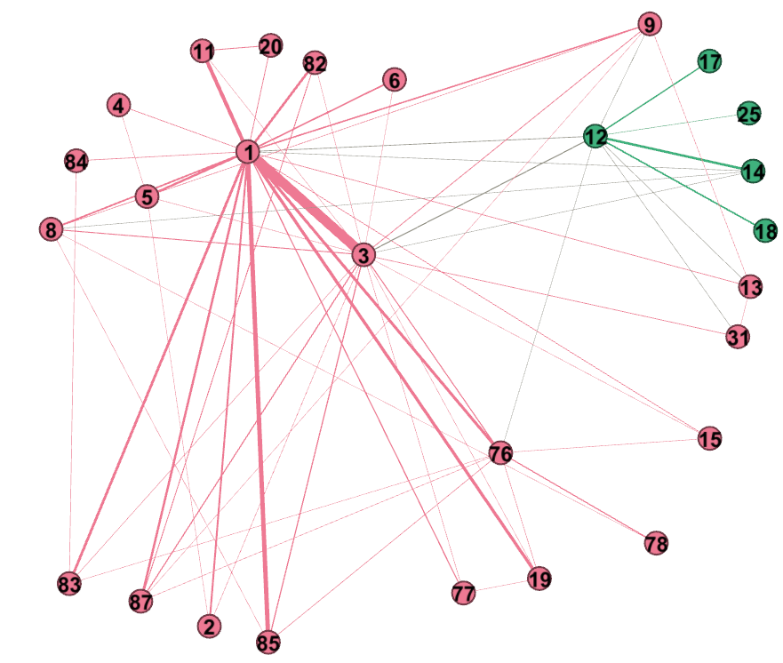
Caviar 6 – Louvain Community Detection 4

Slide 34
Uncertain Communities
Different community detection algorithms (or even multiple runs of a single algorithm) can produce many different results on networks with high uncertainty
Can we decide on a “best” set of communities?
Idea: across different detected community structures, if pairs of nodes frequently appear in a community together then they most likely belong together
“Network Analytics Enabled by Generating a Pool of Network Variants from Noisy Data” (Mandviwalla, Elsisy, Atique, Kuzmin, Gaiteri, Szymanski) published July 2023 in Entropy

Slide 35
Entropy Minimization Heuristic
For a given criminal network we use the RANG BWRN generator to slightly rewire the network r=1000 times
Then we run Louvain community detection on each of these rewired networks r times
This gives us r²=1,000,000 slightly different community structures for the network so we can see which nodes stay paired up most frequently and which do not
We use the measure of Shannon entropy:
$e_{s}^{C}$ = $\sum_{i=1}^{s}{{(p}_{i}^{C}}\ln{p_{i}^{C}})$
To measure the total entropy when comparing a candidate community structure with all of the others
Initially we computed this entropy for each of the r² community structures and found the one with the lowest total entropy but this approach was hurt by the requirement that the best possible community structure would need to have appeared in our r² outputs
So next we build from the ground up the community structure C* which tries to minimize this measure of entropy

Slide 36
Entropy Minimization Heuristic
For a network with N nodes we start with N communities each containing a single node
Using the r² =1,000,000 possible community structures generated we compute the total entropy when merging the first 2 communities together
We repeat this computation for every pair of communities
Whichever merge resulted in the lowest total entropy we keep and then move on to the next round
Repeat until there are no pairs of communities to merge to decrease the total entropy
We save the resulting structure as our candidate structure C* and then repeat the full process again to see if the next candidate structure ends up with a lower total entropy than C*. After two iterations with no decrease we stop

Slide 37
LFR Benchmarks
To test this heuristic, we generate 5 LFR benchmark networks statistically equivalent of the Caviar criminal network with known ground truth community structure:
For a baseline, we run Louvain community detection on these networks 100 times each. Each resulting community structure is compared with Normalized Mutual Information (NMI) to the ground truth.
We run our entropy minimization heuristic on each of the 5 LFR networks to obtain C* and compute its NMI score compared to the ground truth.
This experiment shows that along with having the lowest uncertainty of its community memberships, C* also gets closer to the ground truth than most outputs from a traditional community detection algorithm.

Slide 38
Conclusions
Our entropy minimization heuristic gets closer to the ground truth community structure than the average performance of a popular community detection algorithm like Louvain
It approaches the minimum possible uncertainty in the community memberships
The main flaw of this method is the time complexity of computation – if we reduce r² (the number of candidate structures looked at) the performance also decreases
Future work: we want to try to rewrite the algorithm to retain most of the performance while significantly decreasing the time complexity and also add an option to allow for overlapping communities – PPI networks application

Slide 39
Questions?

